Slide 1
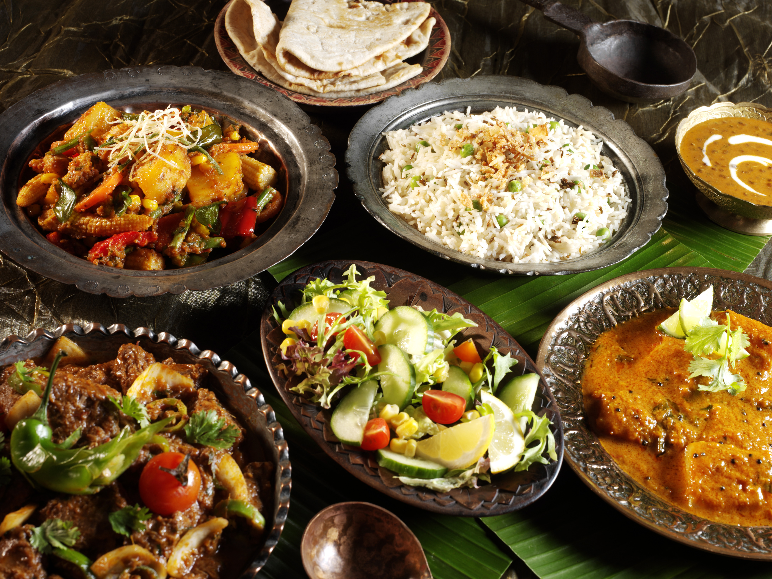


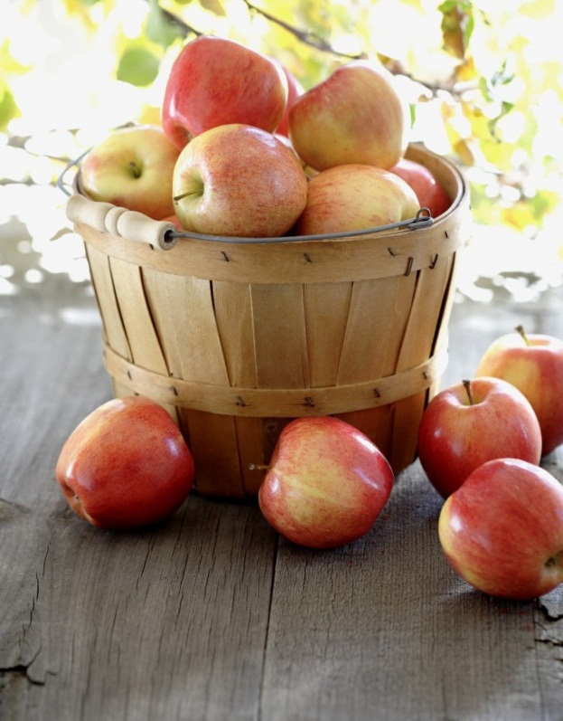
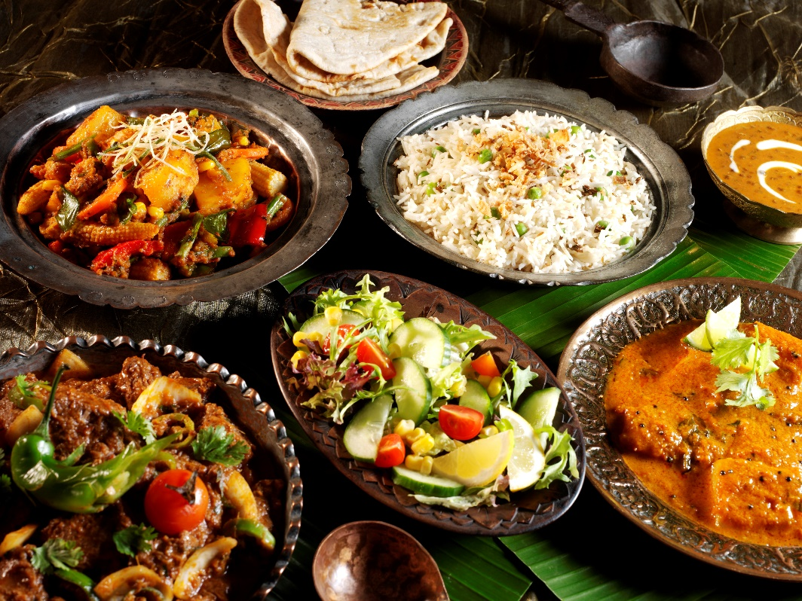

Online Food Ordering System
“Food is Life”
Notes:
NOTE: To replace a picture, just select and delete it. Then use the Insert Picture icon to replace it with one of your own!

Slide 2
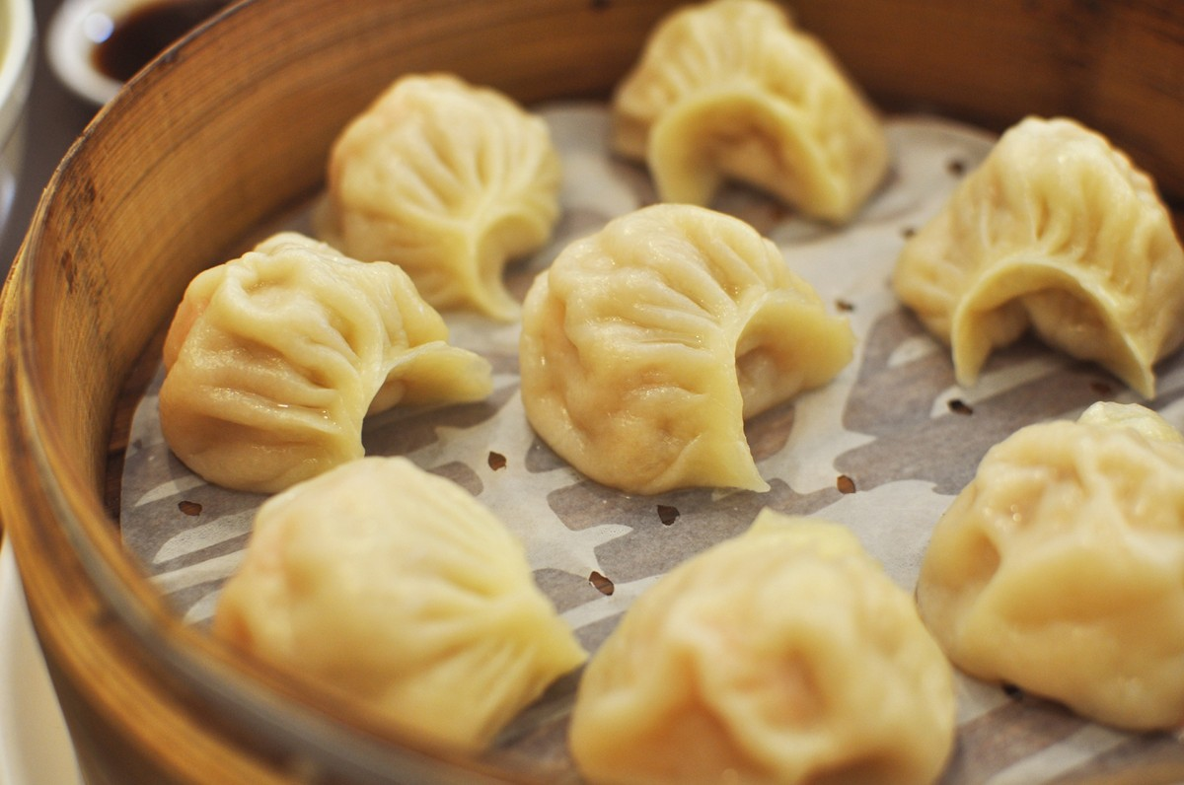
Presented By:-
A
B
C
D
D

Slide 3
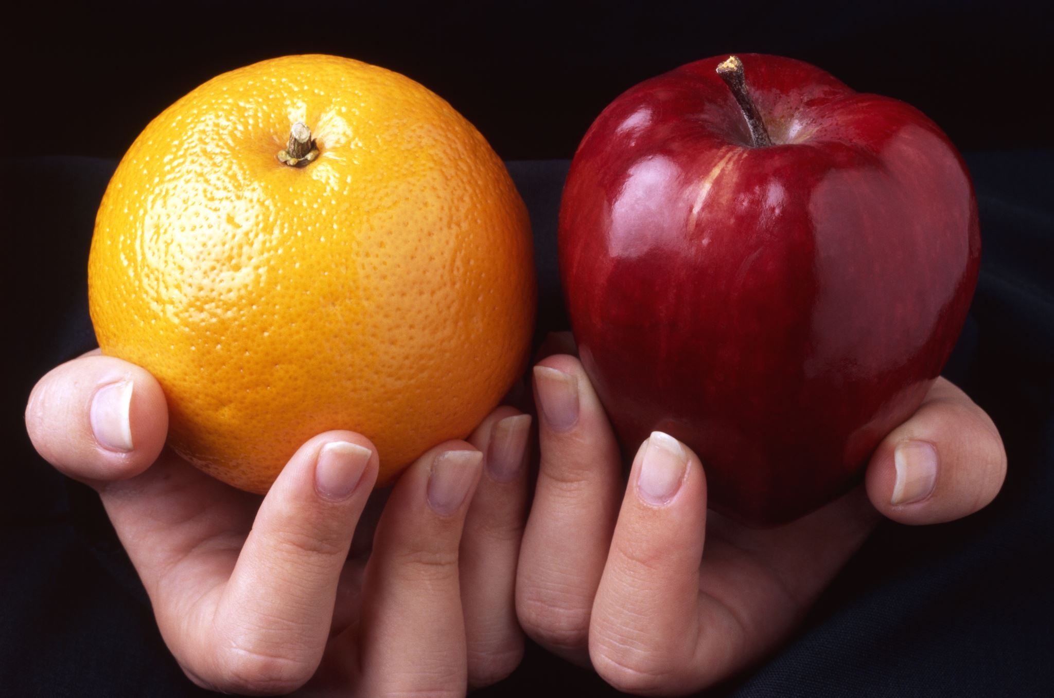
INTRODUCTION
Welcome to our presentation on the fascinating world of online food ordering.
In today's fast-paced digital age, convenience is paramount, and one area where this convenience shines is in the way we order and enjoy our favorite meals.
Over the next few slides, we will delve into the evolution of food ordering, the benefits it offers, and the exciting features that make it a preferred choice for millions around the world.

Slide 4
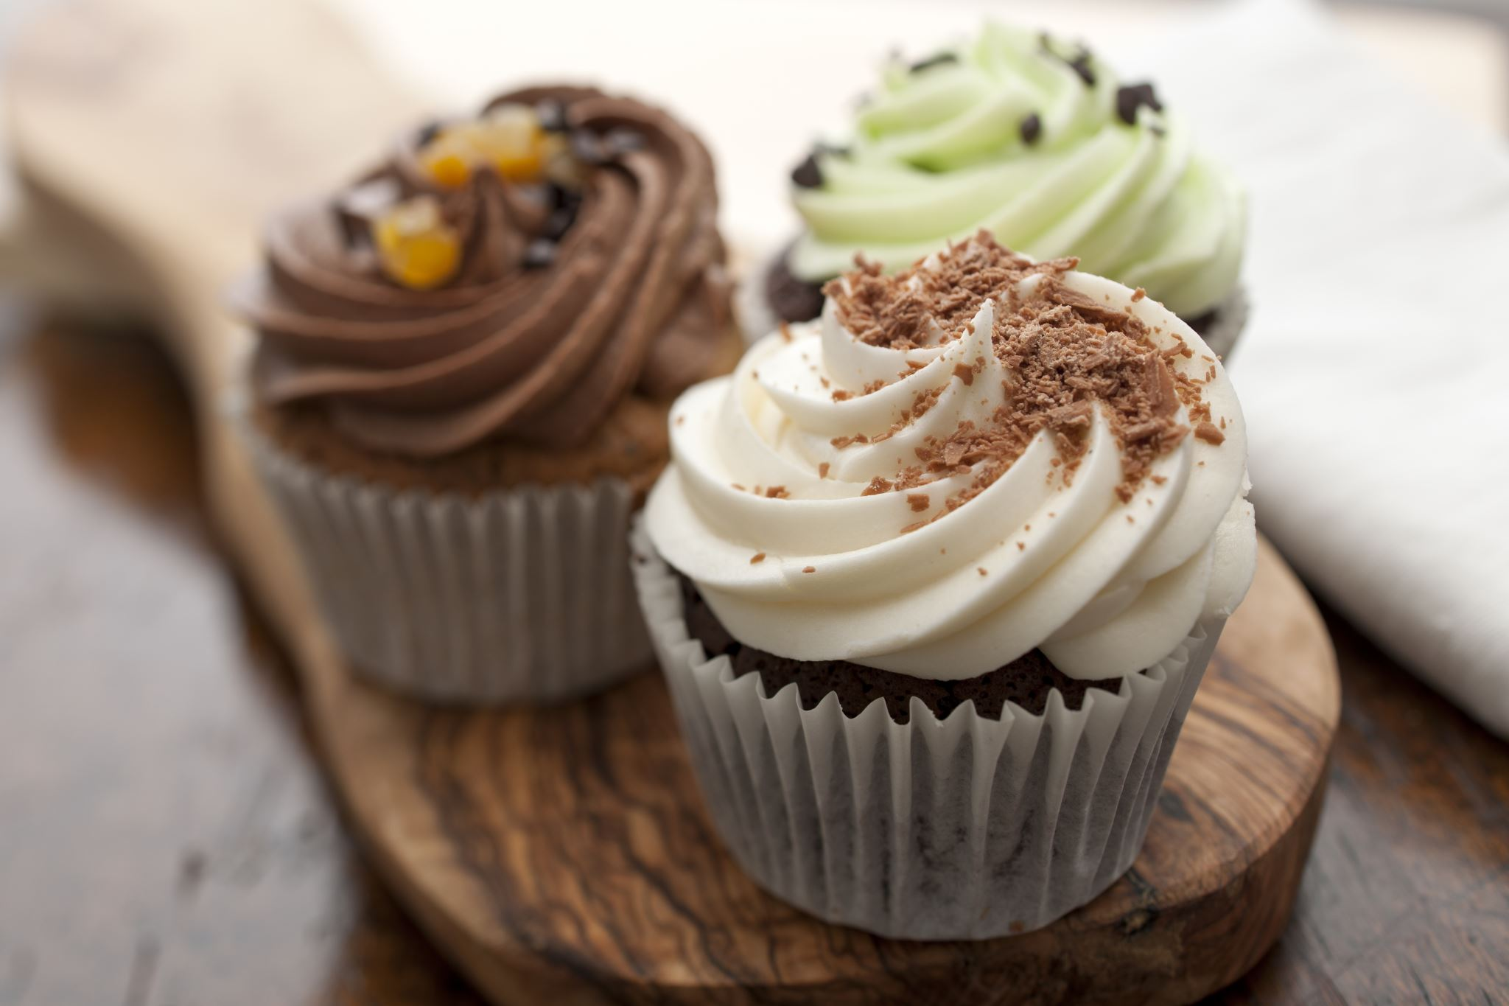

How It Works ?
Write

Slide 5
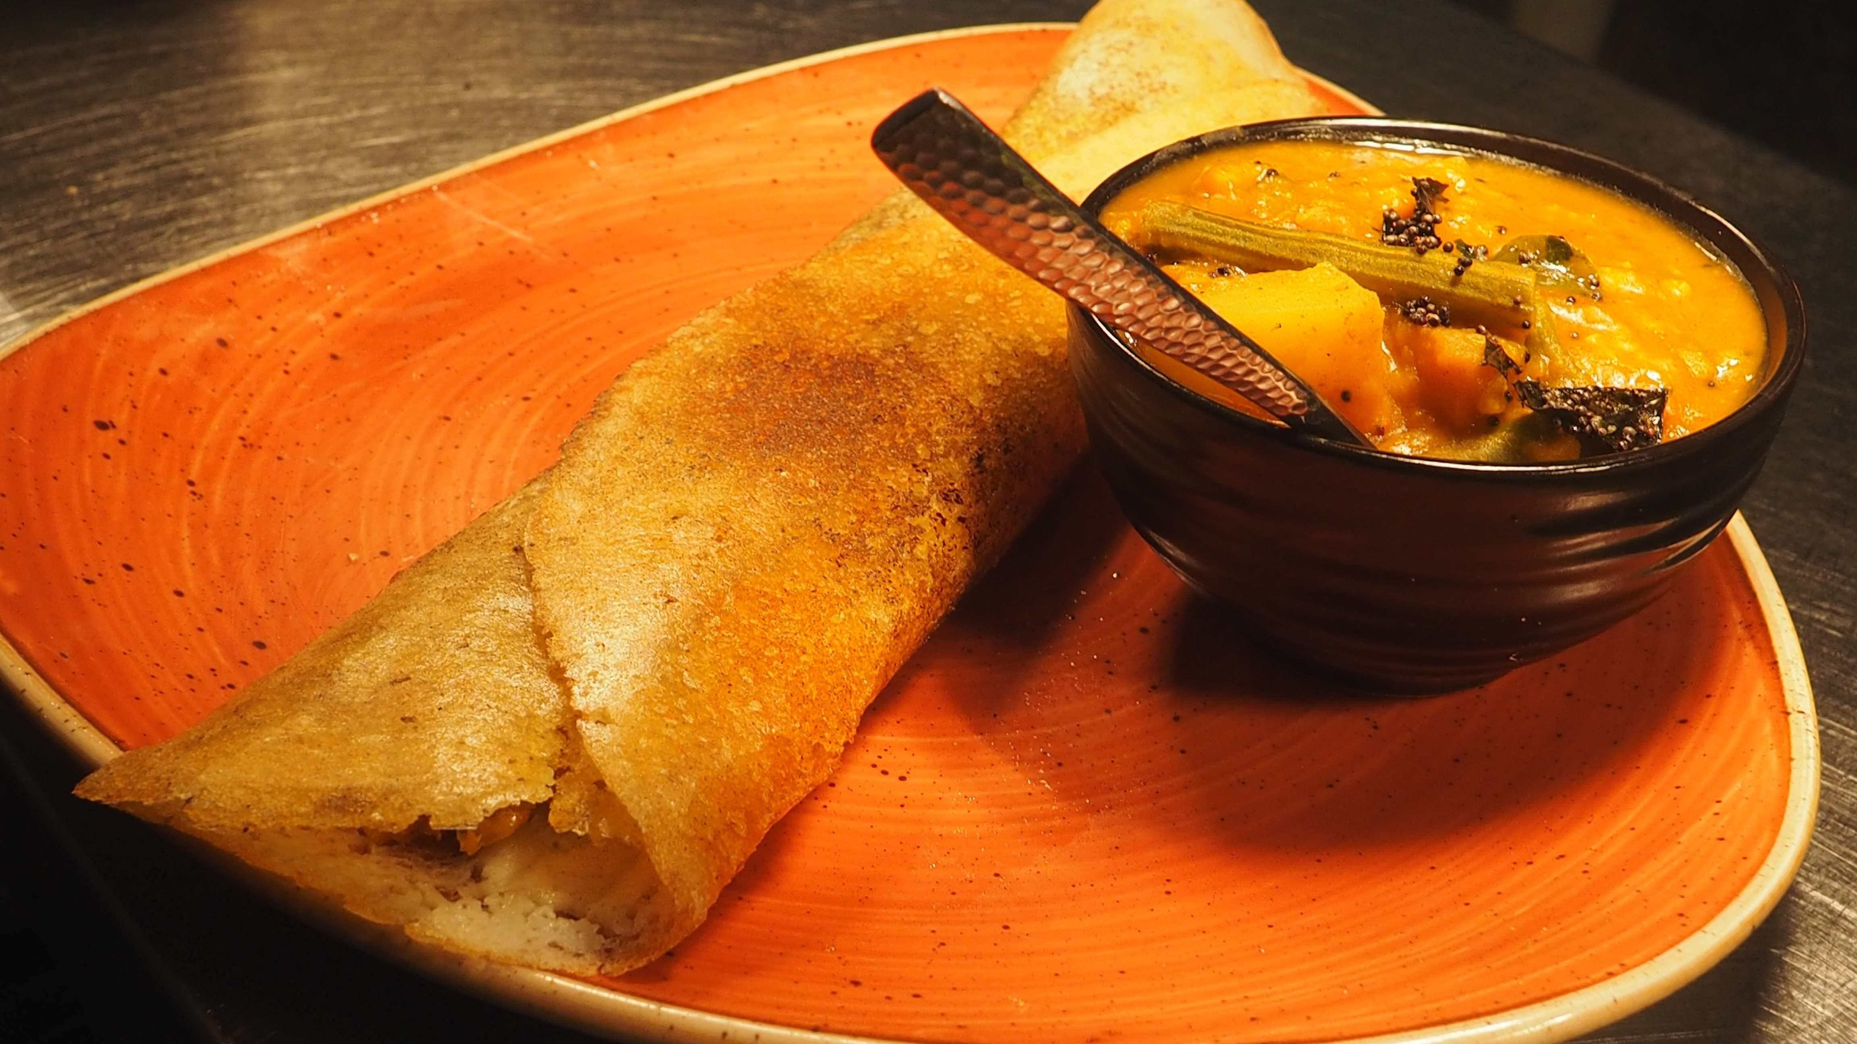


Project Features
1.
2.
3.
4.
5.
6.

Slide 6
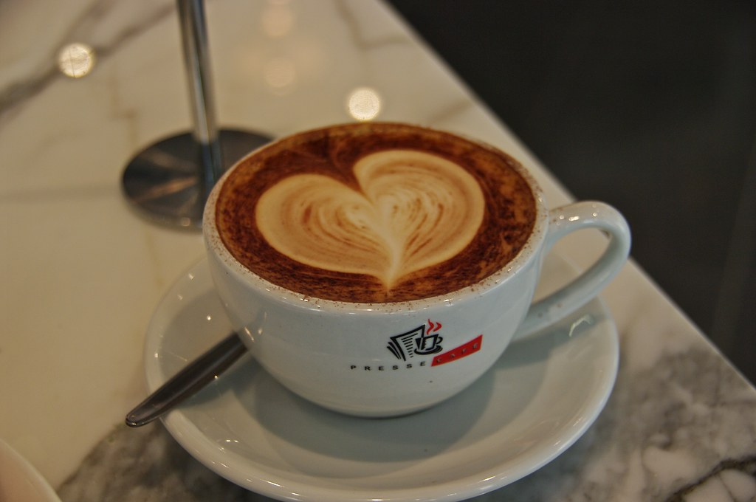


Advantages
Convenience
Time-saving
Variety
Cost-effective
Family-friendly
Health-conscious options
Safety and hygiene
Customer Reviews
User-friendly Apps

Slide 7
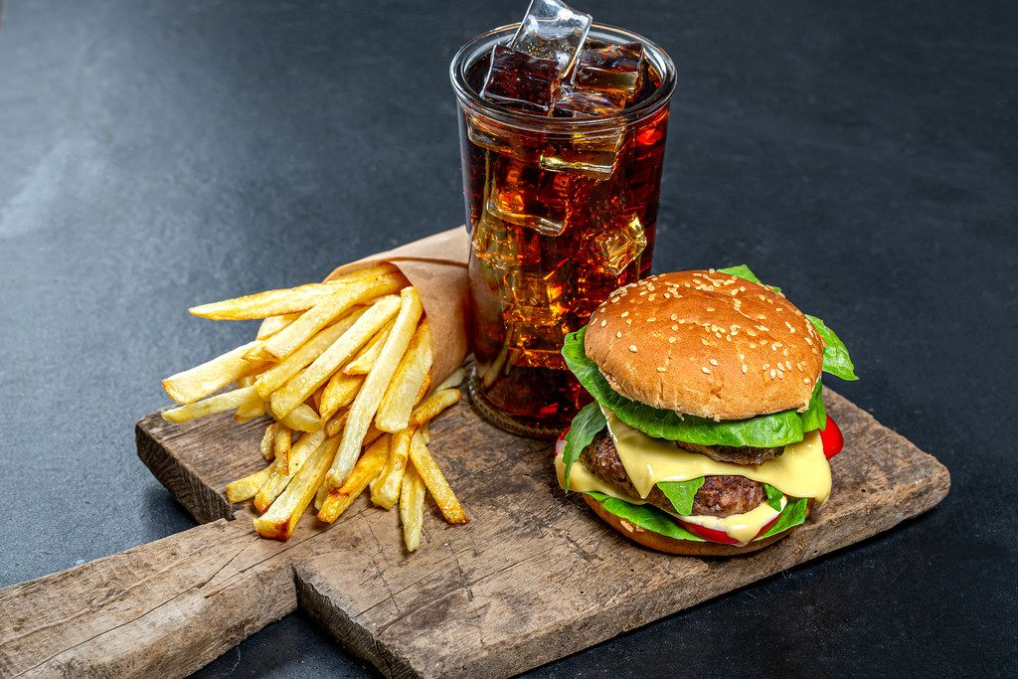

Disadvantages
Technical Glitches
Delivery Delays
Lack of Social Interaction
Environmental Concerns
Extra Costs
Security Risks

Slide 8

Future Scop
Drone Deliveries
AI-Powered Recommendations
Sustainability Focus
Cryptocurrency Payments
Automation in Food Preparation
3D-Food
Augmented Reality Menus

Slide 9

Blank slide

